Slide 1
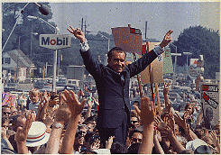
Nixon’s Presidency

Slide 2
At the Beginning
Richard Nixon was elected in 1968 after losing the previous election to LBJ.
At the beginning of Nixon’s presidency, the US was in shambles.
Vietnam had become an enormous disappointment, the country itself was divided, and the assassinations of two very popular figures had made Americans feel unsafe.

Slide 3
A Nixon Success
One of the biggest successes of Nixon was his war on crime.
This was suppose to weaken the rights of the accused because Nixon felt they had gotten out of had.
He blamed the Supreme Court for these problems in the American judicial system.

Slide 4
War on Crime…
Soon after Nixon was elected, the Chief Justice of the Supreme Court, Earl Warren, resigned.
Nixon began to win battles with the Supreme Court.

Slide 5
War on Crime continued…
Warren Burger, a conservative and favorite of Nixon, became the chief justice and Nixon also place three other conservative justices on the court.
It looked as if Nixon was going to get his way with the court (they even reversed the decision that capital punishment was illegal and unconstitutional.

Slide 6
He was a conservative
This means he:
  Defended the status quo
  Opposed rapid change
  Disliked gov’t involvement in economy
  Wanted to give more power to states
In other words—make gov’t smaller, have less of a role in everyday lives

Slide 7
“Law and Order Society”
Nixon kept his campaign promise to restore order to the country
  Used the FBI to spread conflict in civil rights groups
  Used the IRS to audit protestors
  Created an “enemies list” of prominent people who opposed the gov’t.
    Harassed by the gov’t

Slide 8
Law and Order (Nixon Domestic)
Silent Majority- Average American- was tired of protesters
  Protesters= Drugs, crime, declining moral values
  Law and Order vs. Protesters Tension
    Kent State
    Columbia University and Hard Hats
  FBI and Justice Dept- target protest groups and leaders
        Elvis offers his help

Slide 9
Southern Strategy (Nixon domestic)
Slow down civil rights measures
  Hoped to increase support of Southern Whites
  Disregard African American voters
Slow down integration
  Opposed Busing
  Did Not support extending ‘65 Voting Rights Act
  Cut funds to Civil Rights program- Housing
  Gave funds to schools still segregated

Slide 10
New Federalism (Nixon Domestic)
New Federalism- States get more money directly but have to fund their own social programs
Cut back New Deal/ Great Society Social programs
  Welfare = “Welfare cheaters”
Reduce Government spending?
    Military expenditures increased +10%

Slide 11
Supreme Court (Nixon Domestic)
Nixon appointed 4 judges
  Chief- Warren Burger- Moderate
  Harry Blackmun- Conservative
  Lewis Powell, Jr.- Conservative
  William Rehnquist- Conservative
Shifted the court to the Conservative side
  Not friendly towards the Social Movements

Slide 12
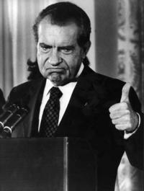
Civil Rights
During his first term, Nixon worked to reverse several civil rights policies:
  Desegregation of schools
  Extension of Voting Rights Act

Slide 13
The Economy
Experienced many problems during this time
Stagflation:
  Inflation was going up
  Unemployment was going up

Slide 14
Slow Inflation (Nixon Domestic)
Inflation- is when the cost of most goods increases faster than average wages do
Deficit Spending
Wage and Price Freezes- Voluntary
OPEC Embargo Sent Inflation Up
    Embargo was retaliation for US involvement in Mideast conflict… leads to… ??
  Gas .25 to .65; Unemployment +9%

Slide 15
Causes of stagflation
Deficit (debt) spending by the gov’t
  Spent more than it collected in taxes
  Due to war and Great Society programs
Competition with goods from Japan and West Germany
Many new workers (women and Baby Boomers)=Unemployment

Slide 16
National Debt
Nixon did inherit a huge national debt because of LBJ’s Great Society and the Vietnam War.
Nixon tried a variety of methods to try and solve this problem, but what he ended up doing was to freeze wages, rents, and product prices

Slide 17
National Debt continued…
Nixon also cut taxes to try and stimulate the economy.
The balance of payments began to become a problem as the US was spending far more than it was making.
Nixon just happened to be President in one of the worst economic periods in US history.

Slide 18
New Federalism
Nixon’s program to reduce the federal gov’t role and put more emphasis on the state and local gov’t.
It called for revenue sharing in which the federal gov’t would give the state gov’t money for them to spend as they saw fit.

Slide 19
South and Latin America (Nixon Foreign)
Realpolitik- leads to support of pro-USA, anti-Communist leaders
    Many, most, leaders Not Democratically elected
    Most are dictators, use military and fear to keep power
    Supplied by US gov’t/ military openly or secretly
    US business benefit, as do dictators (not people)
    Stroesner- Paraguay; Pinochet Chile and more…

Slide 20
Vietnam War (Nixon Foreign)
1969- Vietnamization = troop reduction
Cambodia Bombings- Kent State
1973 Kissinger- set up peace talks
End of American involvement in Vietnam
  All US troops out by end of 1974
  South Vietnam falls to Commies in 1975

Slide 21
Detente (Nixon Foreign)
Relaxing the tension between USA and USSR, and USA and China (both evil Commie Countries)
  Kissinger's influence-
    They were commies- deal with it
  Played one against the other-
    Keep them guessing

Slide 22
China (Nixon Foreign)
1949-1970 US act if China doesn’t exist
      25% of worlds Population - TOO Big to ignore
China and USSR not on good terms
Nixon- Recognizes China 1970; visits 1972
  Set up formal relations
  This put USSR on edge, wondering?
  US and China now on speaking terms
    Part of Cold War Tension

Slide 23
USSR (Russia) (Nixon Foreign)
Nixon visited USSR as well
    China now wondering
Agreed to work together on space, trade and weapons
  SALT I signed- Limited some Nukes
      No limit on warheads-actual bomb part
Showed willingness to work w/ each other
  Cold War Tensions are reduced

Slide 24
Nuclear Weapons (Nixon Foreign)
SALT I Limits ICBM and SLBM (submarine)
Shows gov’t concern for Nuclear threat
  Leads to change in Nuke technology
    Quantity is limited
    Size doesn’t matter
      More powerful smaller warheads
Leads to Salt II (1974) and more reductions

Slide 25
Middle East (Nixon Foreign)
USA supports Israel in 1973 Arab- Israeli War
    Israel vs. Syria and Egypt over territory
    Israel wins quickly (6 day War?)
OPEC (Arab members) start oil embargo
    Embargo- to stop selling or providing a certain product or trade with another group or nation
  Gas prices increase 250% overnight
  Leads to inflation in US
  OPEC and US now see the political power of oil

Slide 26
Oil Issues
US sent military aid to its ally, Israel, during a war with Egypt and Syria
OPEC (Organization of Petroleum Exporting Countries) responded by cutting off all oil sales to the US

Slide 27
1973
Arab nations placed an embargo on oil shipments to the United States.
Nixon urged Americans to take measures to lead toward self-sufficiency in energy usage.
OPEC began to raise prices on oil after the embargo was lifted which contributed to the economic problems that faced the US throughout the 70’s.

Slide 28
When this happened, Americans faced severe oil shortages
  Prices went up
  Long lines
  Factories and schools closed, causing more unemployment

Slide 29
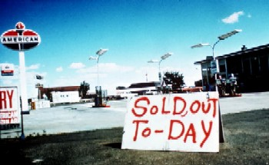

Slide 30
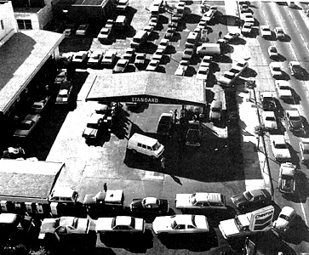

Slide 31
Nixon tried to fix the problem
But his efforts were mostly unsuccessful & the recession continued

Slide 32
Foreign Policy
Wanted to be more flexible and realistic in dealing with other countries, instead of sticking to a rigid plan.
This would include easing relations with communist countries

Slide 33
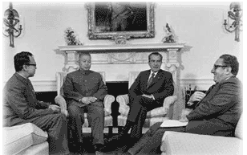
Détente
A policy of easing Cold War tensions

Slide 34
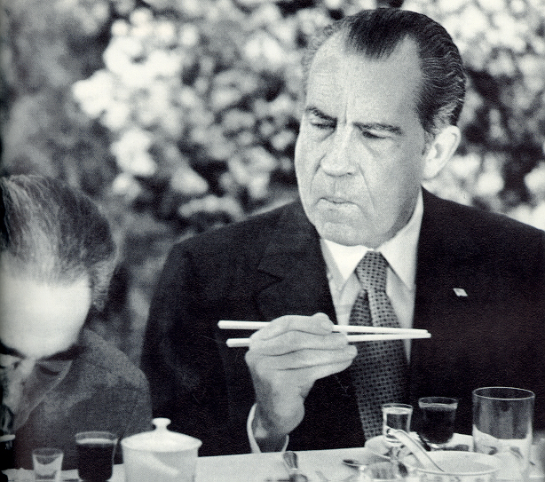
Nixon visits China
  Very important symbolically
  Both sides agreed to work together peacefully

Slide 35
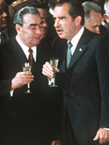
Nixon visits Moscow:
1st president to ever visit USSR
Made agreements concerning East & West Germany
Signed the SALT I treaty:
  Limit the number of ICBMs for 5 yrs

Slide 36
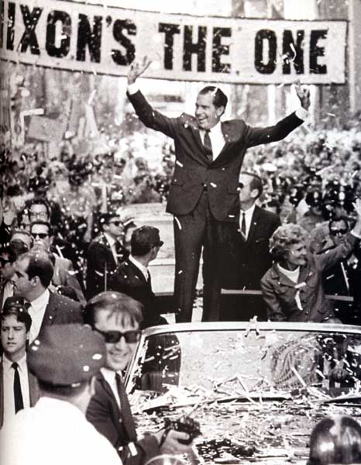
Election of ‘72
Nixon wins, partly b/c of détente, partly because of his promise that peace was just around the corner in Vietnam

Slide 37
But his extreme fear of losing an election causes him to become involved in activities he will later come to regret…

Slide 38
During the campaign…
Five men are caught breaking into the campaign headquarters of the Democratic Party
  They were there to take pictures of Democratic Party documents and to “bug” the phones so they could listen in.
The leader of this group was also a leader in Nixon’s reelection campaign

Slide 39
SECTION
2
The Drive Toward Reelection
A Bungled Burglary
• Committee to Reelect the President break into Democratic headquarters
• Watergate scandal is administration’s attempt to cover up break-in
- destroy documents, try to stop investigation, buy burglars’ silence
Washington Post reporters link administration to break-in
White House denies allegations; little public interest in charges
Nixon reelected by landslide over liberal Democrat George McGovern
NEXT

Slide 40
SECTION
2
The Cover-Up Unravels
The Senate Investigates Watergate
Judge John Sirica presides burglars’ trial, thinks did not act alone
Burglar leader James McCord says lied under oath, advisers involved
Nixon dismisses White House counsel John Dean; others resign
Senator Samuel J. Ervin heads investigative committee
Startling Testimony
Dean declares Nixon involved in cover-up
Alexander Butterfield says Nixon tapes presidential conversations
Continued . . .
NEXT

Slide 41
SECTION
2
continued The Cover-Up Unravels
The Saturday Night Massacre
Special prosecutor Archibald Cox subpoenas tapes; Nixon refuses
Nixon orders Cox fired, attorney general Elliot Richardson refuses
• Saturday Night Massacre: Richardson resigns; deputy refuses, fired
Cox’s replacement, Leon Jaworski, also calls
for tapes
Vice President Spiro Agnew resigns, revealed
he accepted bribes
Nixon nominates, Congress confirms Gerald R. Ford as vice-president
NEXT

Slide 42
The cover up begins…
Workers began destroying documents and paying off those involved
  Nixon’s campaign group handed out $500,000 to those involved to keep them quiet
Nixon denied having any involvement with the situation

Slide 43
Nixon is reelected in November 1972
Public is unaware of his involvement in the Watergate break-in

Slide 44
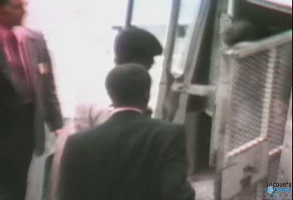

Slide 45
Watergate trial begins
In January 1973
Just before sentencing, one of the burglars admits that he lied under oath and that the White House may have been involved
Nixon publicly denies any involvement and appoints a special prosecutor
  It’s too late—the Senate already begins their own investigation

Slide 46
Senate Hearings
30 hours of testimony
Former aides reveal that Nixon was involved in the cover-up of the break-in
  This is shocking news
Another aide reveals that Nixon had taped nearly all of his conversations
  This starts a long battle by Congress to get the tapes

Slide 47
Around the same time…
It is discovered that VP Spiro Agnew had accepted bribes from engineering firms before and during the time he was VP
He resigns
Nixon appoints Gerald Ford (Representative from MI) to replace him

Slide 48
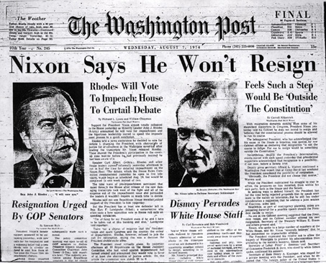
Back to the tapes
Nixon eventually agrees to release edited tapes
  This isn’t good enough for Congress or the American public

Slide 49
The President Resigns
House Judiciary Committee approves 3 articles of impeachment
- formal accusation of wrongdoing while in office
- charges: obstruction of justice, abuse of power, contempt of Congress
Nixon releases tapes; show knows of administration role, cover up
NEXT

Slide 50
The House of Rep begins Impeachment Proceedings
Nixon responds by finally releasing the tapes
They prove that he did know about the break-in and had agreed to obstruct the FBI’s investigation

Slide 51
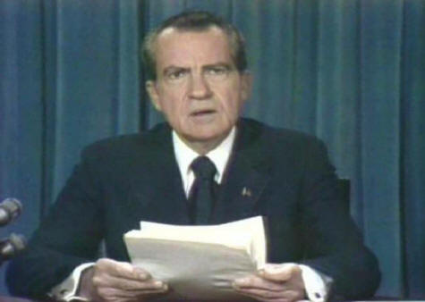
Nixon resigns
August 8, 1974
Didn’t admit guilt, just said he made “wrong” judgments
The Effects of Watergate
25 members of Nixon’s administration convicted, serve prison terms

Slide 52
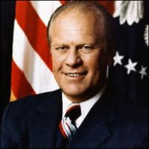
Gerald Ford
Gerald Ford now becomes president
  Appointed VP by Nixon, Ford was never actually elected to the executive branch

Slide 53
Ford Administration
Tried to cut government spending to stop inflation but Democratic Congress passed many spending bills against his wishes.
In foreign affairs, continued détente
Pardoned Richard Nixon for any crime he may have committed. – This angered many Americans and cost him the election

Slide 54
Nixon resignation….
In 1974, Nixon resigned fearing a certain impeachment by Congress.
Gerald Ford immediately pardoned Nixon for all crimes, but that did not sit well with the public.
The issue of presidential power was huge at the end of the Nixon administration.

Slide 55
War Powers Act
Congress passed this to limit the power of the president in military affairs.
Congress also passed the Congressional Budget and Impoundment Act which forced the president to spend any money he attempted to hold onto.

Slide 56
Ford and Congress
They did not help each other
Although leeway was given to Ford, he still couldn’t pass many things through Congress.
In turn, Ford would veto many of the bills Congress sent him.
Aid for Asian countries was not granted to Ford, even though he asked, and Vietnam and Cambodia fell to communist gov’t.
The only real positive thing that came out of the 70’s was the bicentennial which brought a new sense of hope for Americans.

Slide 57
“I’m a Ford, not a Lincoln”
-Gerald Ford

Slide 58
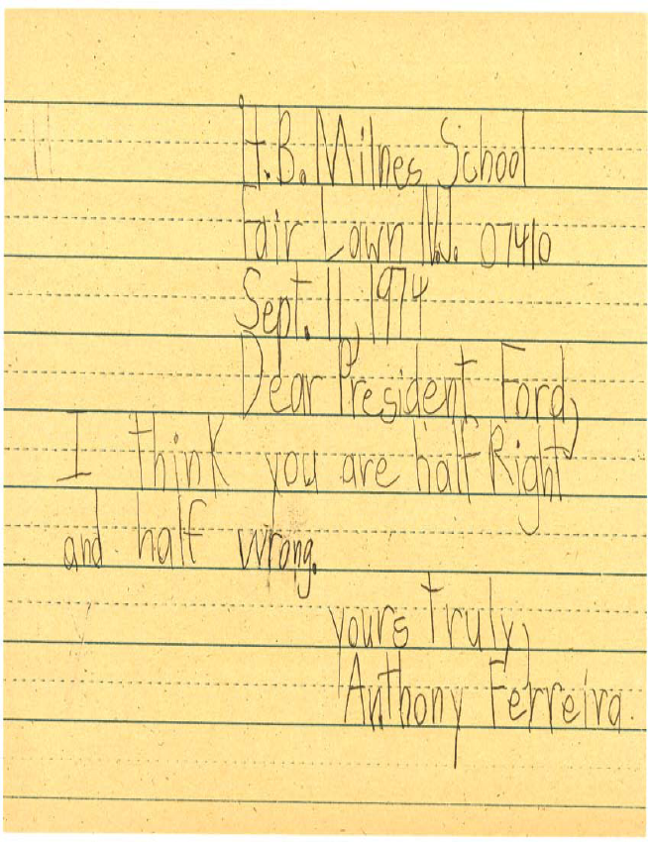

Slide 59
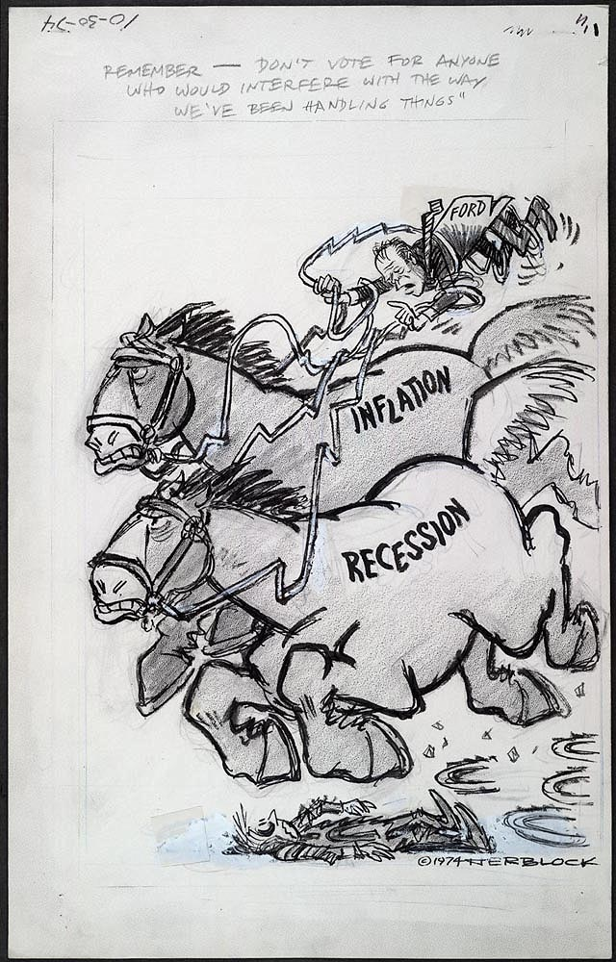

Slide 60
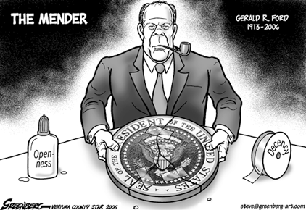

Slide 61
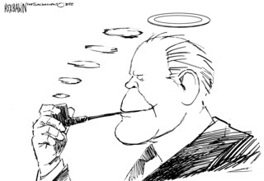

Slide 62


Slide 63
Effects of Watergate
Americans were distrustful of their gov’t and their leaders (and still tend to be today)
Americans developed a negative attitude about elected officials that still exists today

