Slide 1
Essential Question:
What role did presidents Garfield, Arthur, Cleveland, & Harrison play in developing policy during the Gilded Age?
Reading Quiz 19B (p. 663-677)
Notes:
Lesson Plan for Thursday, December 4, 2008: RQ 19B, presidential videos Garfield-Cleveland & class discussion

Slide 2
The Presidents Videos: Garfield—Cleveland
Notes:
Students need to take notes & prepare for a class discussion using the question prompts provided
Video running times: Garfield (30:45-38:00), Arthur (38:00-44:00), Cleveland #1 (0:00-6:00), Harrison (6:00-11:00), Cleveland #2 (11:00-15:00)—total running time of 29:00.

Slide 3
Rank order the following Gilded Age presidents in order of their significance in American history: Grant, Hayes, Garfield, Arthur, Cleveland, Harrison
Notes:
After discussing the discussion questions from the overhead, have the class debate this question.

Slide 4
Essential Question:
How effective were politicians in meeting the needs of Americans during the Gilded Age?
Warm-Up Question:
Watch this film on the “Gilded Age” & answer this question: What was government like in America during the Gilded Age?
Notes:
Lesson Plan for Friday, December 5, 2008: Warm-up question, Politics of the 1890s notes

Slide 5
Essential Question:
How did problems in gov’t (patronage & coinage), the economy (depression of 1893), & agriculture (Populists) impact the politics of the Gilded Age?
Warm-Up Question:
Why might westerners grow frustrated with railroad companies, banks, & the federal gov’t during the Gilded Age?
Notes:
Lesson Plan for Friday, December 5, 2008: Warm-up question, Politics of the 1890s notes

Slide 6
The Politics of the Gilded Age

Slide 7
Politics of Stalemate
No more than 1% of the popular vote separated the candidates in 3 of 5 elections
The 5 presidential elections from 1876 to 1892 were the most closely contested elections ever
Congress was split as well:
Democrats controlled the House
Republicans held the Senate
This “stalemate” made it difficult for any of the 5 presidents or either party to pass significant legislation for 20 years
Pendleton Civil Service Act of 1883
Interstate Commerce Act of 1887
Sherman Antitrust Act of 1890
McKinley Tariff Act of 1890

Slide 8
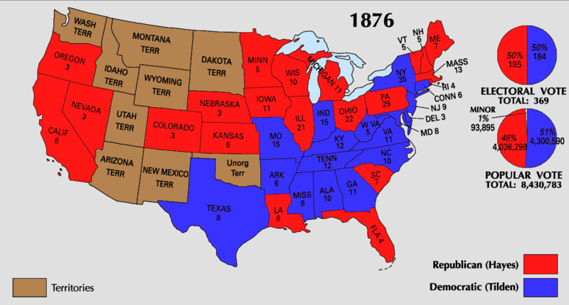
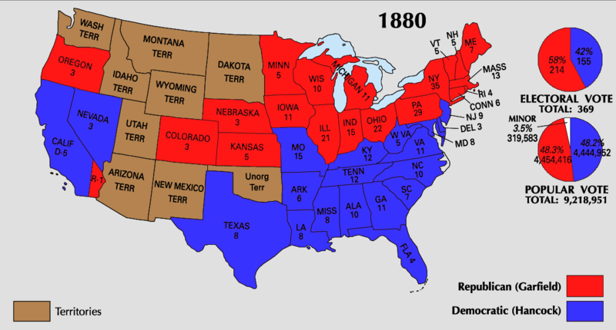
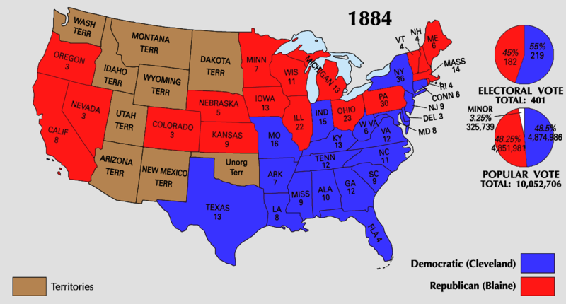
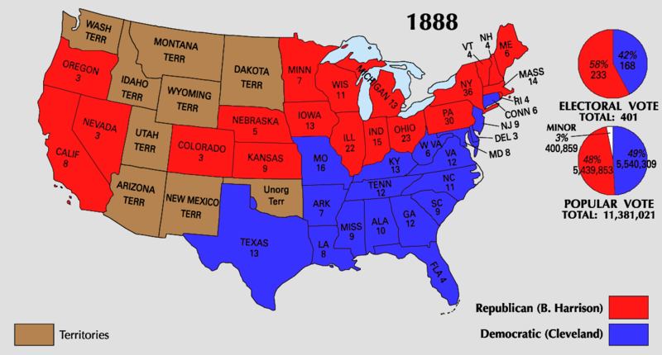
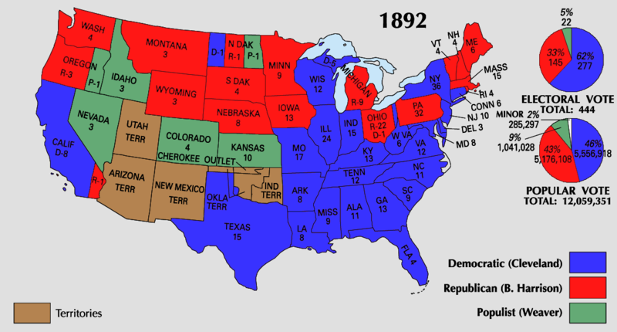
The Two-Party Stalemate: 1876-1892

Slide 9
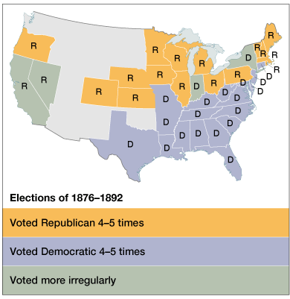
A Two-Party Stalemate
Republicans & Democrats were closely divided in New York, Ohio, & Indiana—these 3 states swung the 5 presidential elections
As a result, 16 of the 20 presidential & VP candidates were from NY, Ohio, or Indiana

Slide 10
Voting Blocs in the Gilded Age
Democratic Bloc
Republican Bloc
Supported by white southerners, farmers, immigrants, & the working poor
Favored white supremacy & supported labor unions
Supported by Northern whites, blacks, & nativists
Supported big business & favored anti-immigration laws

Slide 11
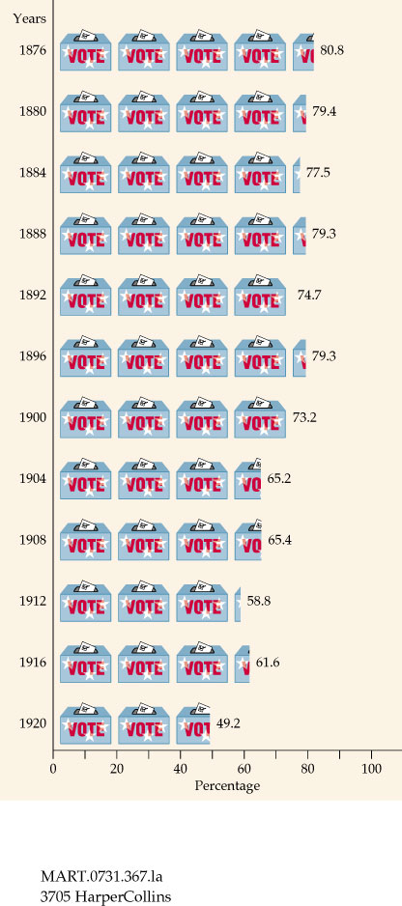
Intense Voter Loyalty to the 2 Parties

Slide 12
Civil Service Reform
Dept of Agriculture & Bureau of Indian Affairs were added
Treasury Dept grew from 4,000 employees in 1873 to 25,000 by 1900
The most important political issue of 1880s was civil service reform:
The federal bureaucracy swelled in size after 1860 & these positions were appointed via patronage (spoils system)
Congressmen often took bribes or company stock for their votes
Political machines ruled cities through bribes & personal favors
56,000 bureaucratic jobs were filled by patronage in 1881

Slide 13
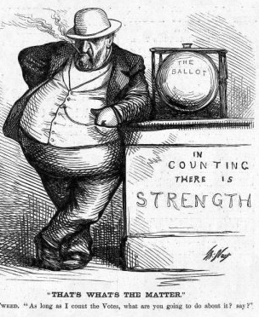
The “Bosses” of the Senate
Boss Tweed of the NYC Democratic Political Machine, Tammany Hall

Slide 14
Civil Service Reform
“If the spoils system could kill a president, it was time to end it”
Civil service reform received a boost when disaffected patronage seeker, Charles Guiteau, assassinated President Garfield:
In 1883, Congress created the Pendleton Act for merit-based exams for civil service jobs
State & local gov’ts mirrored these reforms in 1880s & 1890s

Slide 15
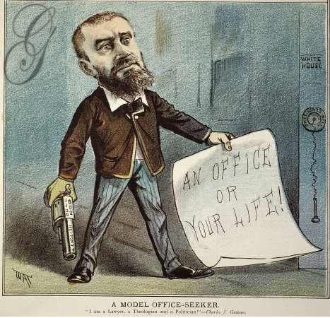
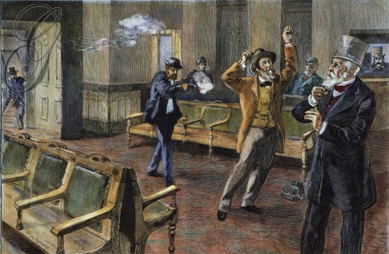
Charles Guiteau assassination of Garfield
Notes:
Charles J. Guiteau shooting President James A. Garfield at the old Baltimore & Potomac R.R. station in Washington, D.C., on 2 July 1881; at right is Secretary of State James G. Blaine:

Slide 16
Gov’t Regulation of Industry
From 1870 to 1900, 28 state commissions were created to regulate industry, especially RRs:
In 1870, Illinois declared RRs to be public highways; this was upheld by Munn v. Illinois (1876)
But, was overturned in Wabash v. Illinois (1886): “only Congress can regulate interstate trade”
Notes:
Munn case “ private property affecting public interest” can be “controlled by public for the common good”

Slide 17
Tariffs & Trusts
This was the 1st attempt by the federal gov’t to regulate big business
The ICC became the model for future regulatory agencies
U.S. v. E. C. Knight Co (1895) was the 1st test of the Sherman Antitrust Act
Congress responded by creating:
The Interstate Commerce Commission (ICC) in 1887 to regulate the railroad industry
The Sherman Antitrust Act in 1890 which made it illegal to restrain trade (punishable by dissolution of the company)
The Supreme Court weakened the Sherman Antitrust Act by ruling that this sugar monopoly do not restrain trade because making a good is not the same as selling it

Slide 18
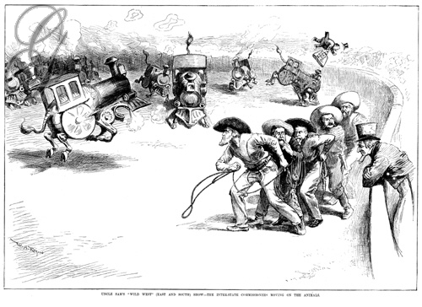
The Interstate Commerce Act

Slide 19
The Depression of 1893
The most serious blow to politics in the Gilded Age was a five-year depression that began in 1893:
A stock market panic occurred when the Philadelphia & Reading Railroad went bankrupt
500 banks, 200 railroads, & 1,500 businesses failed
Companies cut wages & laid off workers; unemployment hit 20%

Slide 20
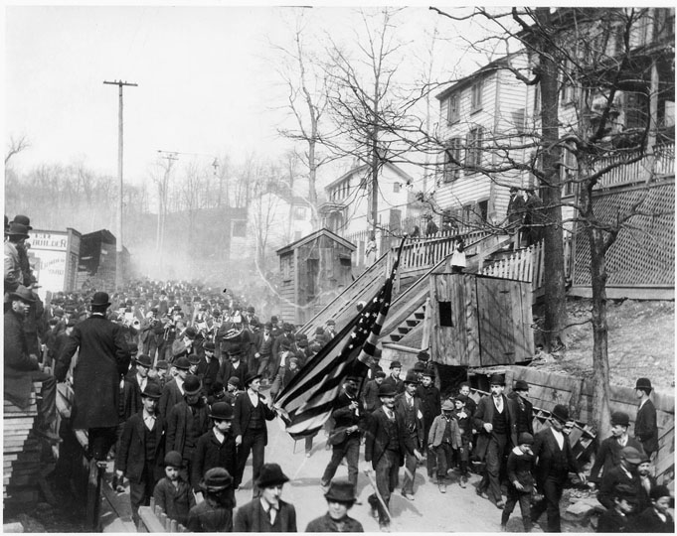
Coxey’s Army (1894)
In 1894, there were 1,400 strikes led by hordes of unemployed people demanding gov’t relief:
Jacob Coxey led an “army” from Ohio to D.C. to convince Congress to create jobs by spending $500 million on new roads

Slide 21
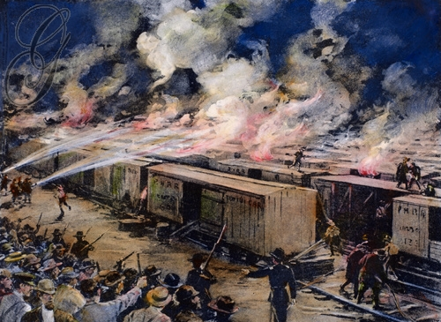
The Pullman Strike (1894)
In 1894, Pullman Palace Car workers went on strike when the company cut wages by 50%
American RR Union leader Eugene V. Debs called for a national railroad strike
President Cleveland issued an injunction & sent the army to end the strike & resume rail traffic
Strikers in 27 states resisted U.S. troops & dozens died
In re Debs in 1895, the Supreme Court upheld the injunction since the strike “restrained” U.S. trade
Notes:
Debs was arrested for violating injunction & gained popularity; turned to socialism in jail & went on to found Socialist Party of America—mixed success in early 1900s

Slide 22
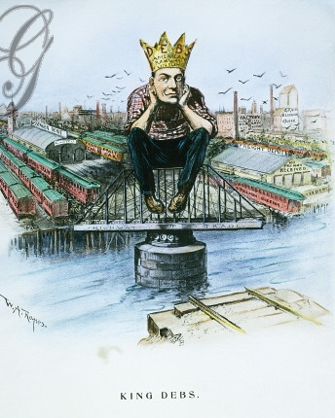
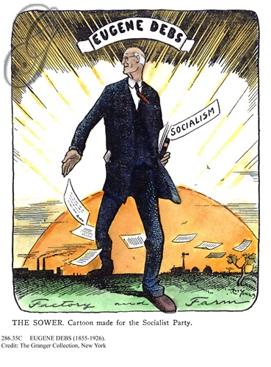
The Pullman Strike (1894)
Effects of the Pullman Strike:
Eugene Debs was arrested & became committed to socialism while in jail, sparking a brief U.S. socialist movement
In the 1895 case, In re Debs, the Supreme Court used the Sherman Antitrust Act to uphold Cleveland’s injunction since the strike “restrained” U.S. trade
This was a clever application of the Sherman Antitrust Act
In re Debs made the Sherman Act a great anti-labor tool
Notes:
Debs was arrested for violating injunction & gained popularity; turned to socialism in jail & went on to found Socialist Party of America—mixed success in early 1900s

Slide 23
Essential Question:
What factors led to the rise of the Populist Party, what were the Populists’ demands, & why were the Populists not more effective in meeting the needs of Americans living in the West?
Reading Quiz 20A (p. 684-700)
Notes:
Lesson Plan for Monday, December 8, 2008: RQ 20A, finish Politics of the 1890s notes, Sham of Democracy activity (CFL #27)

Slide 24
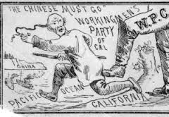

Slide 25
In San Francisco, Irish-born Denis Kearney incited his followers to terrorize the Chinese.
In 1879, Congress passed a bill severely restricting the influx of Chinese immigrants (most of whom were males who had come to California to work on the railroads), but Hayes vetoed the bill on grounds that it violated an existing treaty with China.
After Hayes left office, the Chinese Exclusion Act, passed in 1882, was passed, barring any Chinese from entering the United States—the first law limiting immigration.

Slide 26
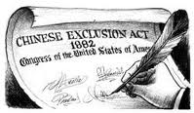

Slide 27
X. Class Conflicts and Ethnic Clashes
In 1877, the presidents of the nation’s four largest railroads decided to cut wages by 10%. Workers struck back, stopping work, and when President Hayes sent troops to stop this, violence erupted, and more than 100 people died in the several weeks of chaos.
The failure of the railroad strike showed the weakness of the labor movement, but this was partly caused by friction between races, especially between the Irish and the Chinese.

Slide 28
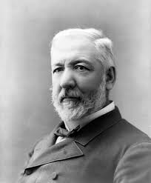
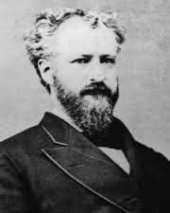
In the 1870s and the 1880s, Republican infighting was led by rivals Roscoe Conkling (Stalwarts) and James G. Blaine (Half-Breeds), who bickered and deadlocked their party.

Slide 29
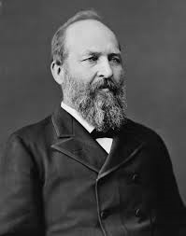
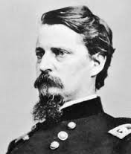
XI. Garfield and Arthur
James A. Garfield
In 1880, the Republicans nominated James A. Garfield, a man from Ohio who had risen to the rank of major general in the Civil War, and as his running mate, a notorious Stalwart (supporter of Roscoe Conkling) was chosen: Chester A. Arthur of New York.
The Democrats chose Winfield S. Hancock, a Civil War general who appealed to the South due to his fair treatment of it during Reconstruction and a veteran who had been wounded at Gettysburg, and thus appealed to veterans.

Slide 30
The campaign once again avoided touchy issues, and Garfield squeaked by in the popular vote (the electoral count was wider: 214 to 155).
Garfield was a good person, but he hated to hurt people’s feelings and say “no.”
Garfield named James G. Blaine to the position of Secretary of the State, and he made other anti-Stalwart acts, but on September 19, 1881, Garfield died after having been shot by a crazy but disappointed office seeker, Charles J. Guiteau, who, after being captured, used an early version of the “insanity defense” to avoid conviction (he was hanged anyway).

Slide 31
On July 2, 1881, he lay in wait for Garfield at the (since demolished) Baltimore and Potomac Railroad Station, getting his shoes shined, pacing, and engaging a cab to take him to the jail later. As Garfield entered the station, looking forward to a vacation with his wife in Long Branch, Guiteau stepped forward and shot Garfield twice from behind, the second shot piercing the first lumbar vertebra but missing the spinal cord. As he surrendered to authorities, Guiteau said: "I am a Stalwart of the Stalwarts. ... [Chester A.] Arthur is president now!'"

Slide 32
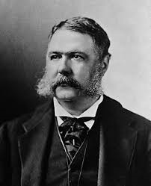
Chester Arthur
Chester Arthur didn’t seem to be a good fit for the presidency, but he surprised many by giving the cold shoulder to Stalwarts, his chief supporters, and by calling for reform, a call heeded by the Republican party as it began to show newly found enthusiasm for reform.

Slide 33
The Pendleton Act of 1883, the so-called Magna Charta of civil-service reform (awarding of government jobs based on ability, not just because a buddy awarded the job), prohibited financial assessments on jobholders, including lowly scrubwomen, and established a merit system of making appointments to office on the basis of aptitude rather than “pull.”
It also set up a Civil Service Commission, charged with administering open competitive service, and offices not “classified” by the president remained the fought-over footballs of politics.
Luckily, Arthur cooperated, and by 1884, he had classified nearly 10% of all federal offices, or nearly 14,000 of them.

Slide 34
The Pendleton Act partially divided politics from patronage, but it drove politicians into “marriages of convenience” with business leaders.

Slide 35
The Blaine-Cleveland Mudslingers of 1884
James G. Blaine became the Republican candidate, but some Republican reformers, unable to stomach this, switched to the Democratic Party and were called Mugwumps.
The Democrats chose Grover Cleveland as their candidate but received a shock when it was revealed that he might have been the father of an illegitimate child.

Slide 36
The campaign of 1884 was filled with perhaps the lowest mudslinging in history.
The contest depended on how New York chose, but unfortunately, one foolish Republican insulted the race, faith, and patriotism of New York’s heavy Irish population, and as a result, New York voted for Cleveland; that was the difference.

Slide 37
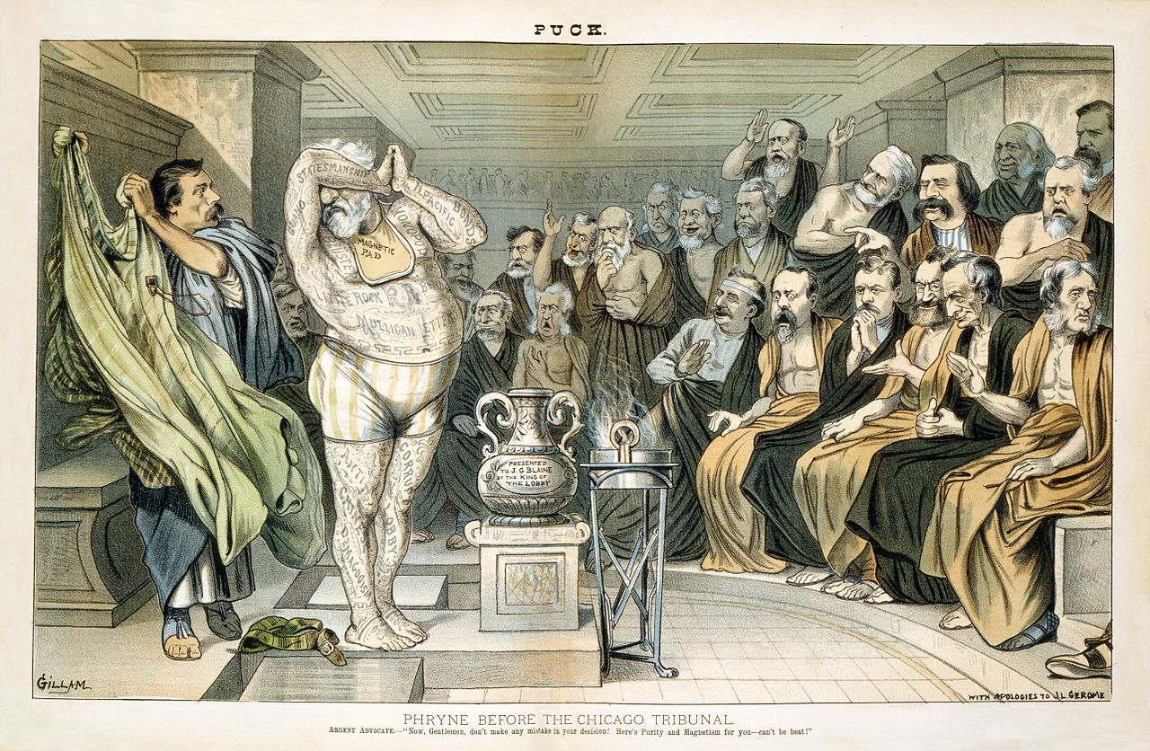

Slide 38
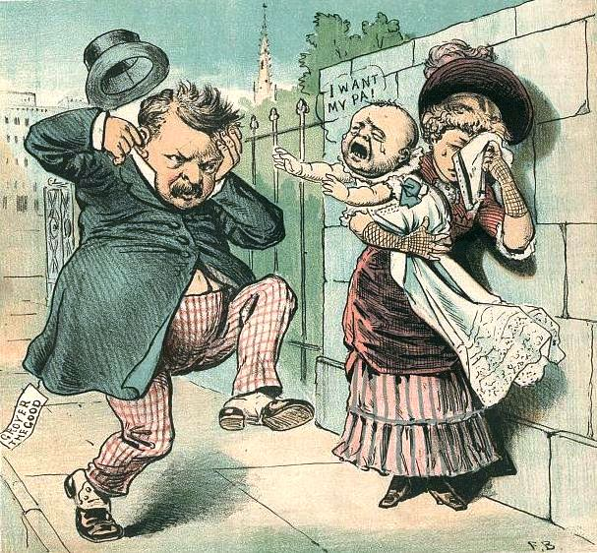

Slide 39
“Old Grover” Takes Over
Portly Grover Cleveland was the first Democratic president since James Buchanan, and as a supporter of laissez-faire capitalism, he delighted business owners and bankers.
Cleveland named two former Confederates to his cabinet, and at first tried to adhere to the merit system (but eventually gave in to his party and fired almost 2/3 of the 120,000 federal employees), but he had his problems.

Slide 40
Military pensions plagued Cleveland; these bills were given to Civil War veterans to help them, but they were used fraudulently to give money to all sorts of people.
However, Cleveland showed that he was ready to take on the corrupt distributors of military pensions when he vetoed a bill that would add several hundred thousand new people on the pension list.

Slide 41
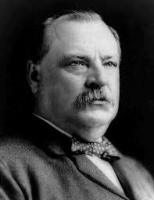
Cleveland Battles for a Lower Tariff
By 1881, the Treasury had a surplus of $145 million, most of it having come from the high tariff, and there was a lot of clamoring for lowering the tariff, though big industrialists opposed it.
Cleveland wasn’t really interested in the subject at first, but as he researched it, he became inclined towards lowering the tariff, so in late 1887, Cleveland openly tossed the appeal for lower tariffs into the lap of Congress.

Slide 42
Democrats were upset at the obstinacy of their chief while Republicans gloated at his apparently reckless act.
Tariffs on imports mean higher prices, thus higher wages for workers. It turn, it means higher tariffs placed on US goods being exported as other countries return the favor of raising tariffs. This hurts international trade.
Farmers made up the bulk of international trade. To raise a tariff helps big business and hurts farmers who need bigger markets to sell all of their crops. A surplus of crops in America means lower prices.

Slide 43
XV. The Billion Dollar Congress
The new Speaker of the House, Thomas B. Reed, was a large, tall man, a tremendous debater, and very critical and quick man.
To solve the problem of reaching a quorum in Congress, Reed counted the Democrats who were present yet didn’t answer to the roll call, and after three days of such chaos, he finally prevailed, opening the 51st, or “Billion Dollar” Congress—one that legislated many expensive projects.

Slide 44
To ensure their popularity, the Billion Dollar Congress passed pensions for Civil War veterans (remember the Southern states did not fight for the US and thus are ineligible for pensions, but will be forced to pay taxes to support these pensions)
Congress approved the purchase of silver for use as coinage to increase revenue flow, thus lowering the value of money on the market.
The McKinley Tariff Act of 1890 raised taxes on some imported goods to the all-time high of 48.4%

Slide 45
In The News!

Slide 46
The Hillary Chronicles

Slide 47
IRS says criminals actually stole data on 330,000 -- three-times more than previously believed
Until this spring, the IRS website provided a tool called "Get Transcript." It was meant to help taxpayers who lose track of old tax documents. They could easily download several years of tax forms for tasks like applying for a mortgage or college financial aid.
It's a popular tool. Earlier this year, Americans used it to download 23 million transcripts, the agency said.
To keep out fraudsters, the "Get Transcript" tool asked for lots of personal information before granting access: Social Security numbers, birthdays, physical addresses and more.
But thanks to the many data breaches nowadays, much of this information is already online.
Apparently, an unnamed cybermafia used previously acquired stolen information to dupe the "Get Transcript" tool -- and downloaded millions of people's tax documents.

Slide 48
Morgan Freeman’s step-grand daughter stabbed to death in ritual
The step-granddaughter of award-winning actor Morgan Freeman was killed by her boyfriend early Sunday in a disturbed attempt at an exorcism, according to a published report.
The New York Post reported that Edena Hines, 33, — whose grandmother was Freeman’s first wife — was stabbed 16 times near her apartment building on West 162nd St. in the Washington Heights section of Manhattan just before 3 a.m.

Slide 49
The Post reported that police officers had to physically restrain Davenport from continuing his attack and further brutalizing Hines' lifeless body. A police source told the Post that the suspect "was still making a stabbing motion with his arm, but he had nothing in his fist — the knife was jutting out of her chest."
Davenport was described by law enforcement sources as an aspiring rapper who performed under the name Lyric. He is the father of two young children — neither with Hines — and has a history of abusing drugs and alcohol. He has six prior arrests, including for marijuana possession and petty larceny.

Slide 50
Ex-officials prosecuted for mishandling gov’t info see ‘double standard’ in Clinton case
Ex-officials who were prosecuted and had their lives upended for allegedly mishandling sensitive records are accusing the Obama administration of a "double-standard" in its approach to the Hillary Clinton email scandal.
This administration has charged more people under the Espionage Act, a World War I-era law once used to go after major breaches, than any other in history. While the FBI is looking into Clinton's server amid revelations of state secrets potentially passing through it, some critics -- including those charged under that act -- doubt the Democratic presidential candidate will get the same treatment.

Slide 51
Trump reports for New York jury duty, takes campaign break
Jury assembly supervisor Irene Laracuenta told the possible jurors that their commitment would be either one day or one civil trial, depending on whether they were selected.
"No one -- no one -- gets special treatment," Laracuenta said.
If Trump isn't picked for a jury by the end of Monday, he's exempt from jury duty for the next six years. Jurors who do get chosen are told to expect to sit for at least one week, but trials can last for months.

Slide 52
Pentagon plans to increase drone flights by 50 percent by 2019
The Pentagon plans to sharply expand the number of U.S. drone flights over the next four years, giving military commanders access to more intelligence and greater firepower to keep up with a sprouting number of global hot spots, a senior defense official said.
The plan to increase by 50 percent the number of daily drone flights would broaden surveillance and intelligence collection in such locales as Ukraine, Iraq, Syria, the South China Sea and North Africa
Strikes by unmanned aircraft have killed 3,000 people or more

Slide 53
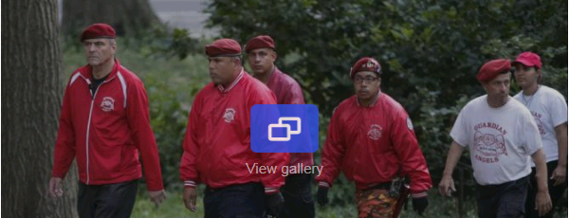
After decades, Guardian Angels resume Central Park rounds
It was a familiar sight a generation ago, when New York was plagued by lawlessness that police have worked for years to dispel. Yet Guardian Angels volunteers made a pointed return this month to Central Park for the first time in over two decades, citing a 26 percent rise in crime there so far this year.

Slide 54
Woman caught trying to break into jail, officials say Talisha McCann arrested in Alabama
Surveillance video shows Talisha McCann using bolt cutters to try and cut her way into the prison yard, according to authorities.
Prison guards were able to scare her off, and when deputies caught up to her, they said they found two gallon-sized bags of tobacco, a small amount of pain medication and a cellphone.
Deputies said McCann had been released from the jail two weeks earlier.

Slide 55
Ohio Gov. John Kasich on Monday landed the endorsement of fellow governor Robert Bentley of Alabama, as the presidential hopeful seeks to build support for his White House bid and courts voters in the South.
"I have watched him over the years and I chose him because of his heart," Bentley said, adding that he believes the two have similar approaches toward governing.
Kasich said Bentley has made Alabama's state government more efficient and isn't afraid to lead. Alabama faces a $300 million general fund budget shortfall that lawmakers will again face during a second special session.

Slide 57
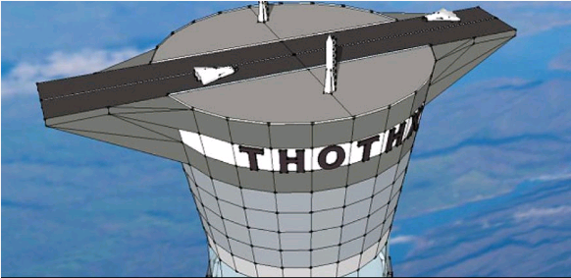
Company receives patent for 'space elevator'
Canadian firm Thoth Technology has been granted a U.S. patent for a space elevator. The proposed "freestanding space tower" would reach a little over 12 miles above the Earth, according to an announcement from the company.
It would stand 20 times the height of current tall structures, according to Thoth Technology, and could be used for wind-energy generation, tourism, and communications. It would save 30 percent of the fuel of a normal rocket, the company said.
Once an astronaut would ascend 12 miles through the elevator to the top of the tower, "space planes will launch in a single stage to orbit," returning back and forth to the tower for refueling,

Slide 58
Army Ranger School to graduate its first two women
Two women have made military history by becoming the first female soldiers to complete the U.S. Army's grueling Ranger Course, the Army announced late Monday.
The women, who were not immediately identified, will join 94 men Friday for a graduation ceremony at Fort Benning, Ga., where Ranger School is based. The unit consists of rapidly deployable troops who are often used in special operations.

Slide 59
Construction worker unearths a mass grave in Pennsylvania
A construction worker may have unearthed a mass grave while digging last week on private property in Schuylkill Haven, Pa. Local historians say the bones could very well belong to those who died during the 1918 Spanish influenza pandemic, which wiped out 1,600 people in a month in this county alone.

Slide 60
Cleveland and Depression
No sooner than Cleveland had stepped into the presidency did the Depression of 1893 break out. It was the first such panic in the new urban and industrial age, and it caused much outrage and hardships. This completed the almost predictable, every-20-year cycle of panics during the 1800s (panics occurred during 1819, 1837, 1857, 1873, and 1893).

Slide 61
About 8,000 American business houses collapsed in six months, and dozens of railroad lines went into the hands of receivers.
This time, Cleveland had a deficit and a problem, for the Treasury had to issue gold for the notes that it had paid in the Sherman Silver Purchase Act, and according to law, those notes had to be reissued, thus causing a steady drain on gold in the Treasury—the level alarmingly dropped below $100 million at one point.

Slide 62
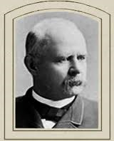
Meanwhile, Grover Cleveland had developed a malignant growth under the roof of his mouth, and it had to be secretly removed in a surgery that took place aboard his private yacht; had he died, Adlai E. Stevenson, a “soft money” (paper money) man, would have caused massive chaos with inflation.

Slide 63
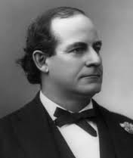
Also, 33 year-old William Jennings Bryan was advocating “free silver,” and gaining support for his beliefs, but an angry Cleveland used his executive power to break the filibuster in the Senate—thus alienating the silver-supporting Democrats.

Slide 64
The Farmers’ Movements & the Rise of the Populists

Slide 65
Political Organization
The Gilded Age saw a rise in political organization among disaffected Americans:
Labor unions (like the Knights of Labor & the AFL) encouraged industrial workers to vote
Women’s Christian Temperance Union (WCTU) advocated temperance, race relations, & the right for women to vote

Slide 66
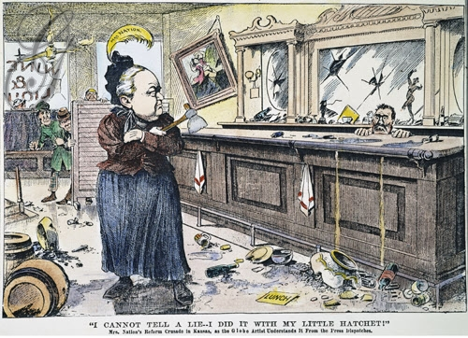
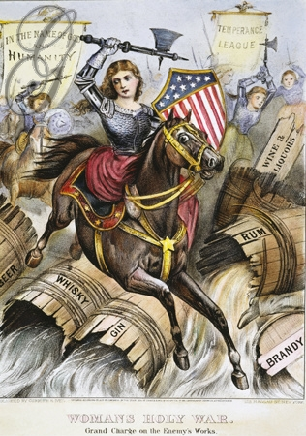
The great temperance agitator—Carrie Nation

Slide 67
The Farm Problem
The most discontent group during the Gilded Age were farmers:
Harsh farming conditions
Declining grain & cotton prices
Rising RR rates & mortgages
Government deflation policies
Farmers lashed out at banks, merchants, railroads, & the U.S. monetary system (gold standard)
Notes:
Many farmers blamed railroad owners, grain elevator operators, land monopolists, commodity futures dealers, mortgage companies, merchants, bankers, and manufacturers of farm equipment for their plight. Many attributed their problems to discriminatory railroad rates, monopoly prices charged for farm machinery and fertilizer, an oppressively high tariff, an unfair tax structure, an inflexible banking system, political corruption, corporations that bought up huge tracks of land. They considered themselves to be subservient to the industrial Northeast, where three-quarters of the nation's industry was located. They criticized a deflationary monetary policy based on the gold standard that benefited bankers and other creditors.
All of these problems were compounded by the fact that increasing productivity in agriculture led to price declines. In the 1870s, 190 million new acres were put under cultivation. By 1880, settlement was moving into the semi-arid plains. At the same time, transportation improvements meant that American farmers faced competitors from Egypt to Australia in the struggle for markets.

Slide 68
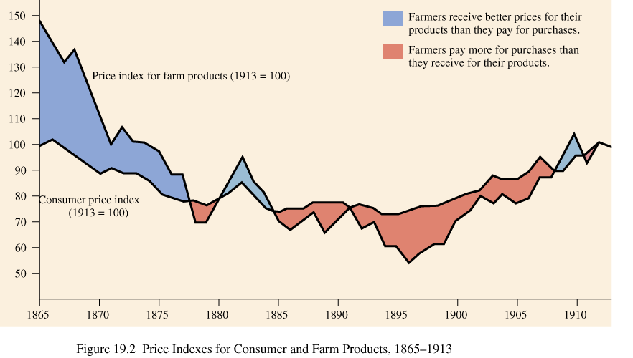
Price Index for Consumer & Farm Goods (1865-1915)

Slide 69
The Currency Debate
Grant’s decision to reduce the number of greenbacks deflated the post-war money supply:
By 1879, the U.S. returned to the international gold standard & stabilized the U.S. economy
But this policy hurt western farmers because money was more scarce & credit was limited

Slide 70
Greenback & Silver Movements
This would lead to inflation & someone would consistently buy silver from miners
Many farmers supported the “free silver” movement:
The U.S. minted silver & gold coins at a ratio of 16:1, but stopped in 1873 due to an oversupply of gold
But western miners found huge lodes of silver & wanted “free silver”—the gov’t should buy all silver from miners & coin it
In 1878, Congress passed the Bland-Allison Act to coin between $2-4 million in silver coins
In 1890, Congress passed the Sherman Silver Purchase Act to increase silver coinage but not to 16:1 (the act was repealed in 1893)
Notes:
Bland-Allison Act was not successful in deflating the US money supply—hence the frowny face

Slide 71
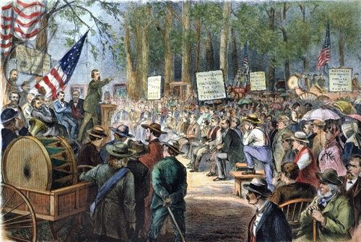
The Granger Movement
The 1st attempt to organize farmers began with the Grangers:
Grangers grew angry at the exploitive practices of Eastern bankers, railroads, & wholesalers
Grangers formed co-op stores, banks, & grain elevators
The Grange died in the depression of the 1870s, but established the precedent of farmer organization

Slide 72
The National Farmers’ Alliance
In 1890, the National Farmers’ Alliance replaced the Grange as the leading farmers’ group
In 1890, made Ocala Demands:
Allow farmers to store crops in gov’t silos when prices are bad
Free-coinage of silver, a federal income tax, & regulation of RRs
Direct election of U.S. senators

Slide 73
The Populist Party
In 1890, farmers & factory workers formed the Populist Party:
Their platform included the Ocala Demands, an 8-hour day, gov’t control of RRs & banks, the breakup of monopolies, & tighter immigration restrictions
Populists emerged as a powerful 3rd party & got numerous state & national politicians elected
3 governors, 10 congressmen, 5 senators, & dominated the state governments of Idaho, NV, CO, KS, & ND

Slide 74
The Election of 1892
In 1892, the Populists ran presidential candidate James Weaver against Democrat Grover Cleveland & Republican Benjamin Harrison
Upon his election, Cleveland called for and received the repeal of the Sherman Silver Purchase Act which alienated Southern & Western Democrats from the party
Even Midwestern farmers did not vote Populist
Southern Democrats used racism & intimidation to remind whites of the “bloody flag”
Black farmers voted Republican & did not support the Populists

Slide 75
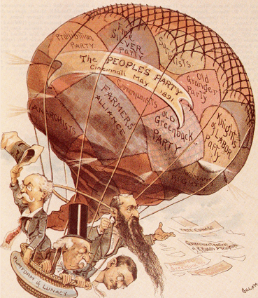
Platform of Lunacy

Slide 76
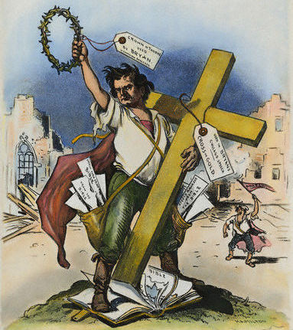
The Election of 1896
A Populist-Democrat merger looked possible in 1896 when William Jennings Bryan received the Democratic nomination against Repub William McKinley:
Called for free silver & income tax; attacked trusts & injunctions
Bryan visited 26 states on his whistle-stop campaign to educate Americans about silver
“Having behind us the producing masses…we will answer their demand for the gold standard ‘You shall not press down upon the brow of labor this crown of thorns, you shall not crucify mankind upon a cross of gold.’”

Slide 78
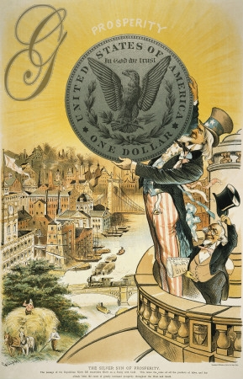
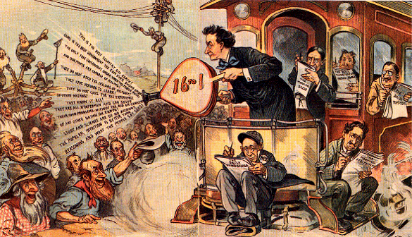
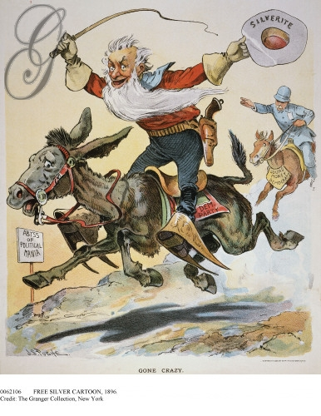
Bryan: The Farmers’ Friend
OR?
18,000 miles of campaign “whistle stops”

Slide 79
The Election of 1896
Advised by RNC chairman, Mark Hanna, McKinley waged a “front porch” campaign from Ohio
Aided by the press, McKinley’s message reached as many voters:
Advocated economic, urban, & industrial growth
Aroused fear that a “free silver” victory would result in 57¢ dollar

Slide 80
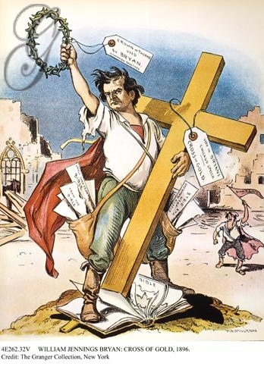
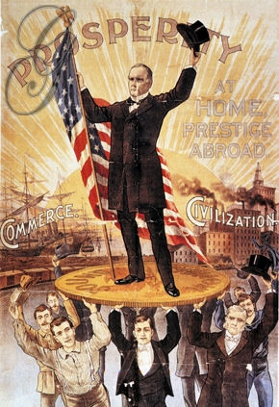
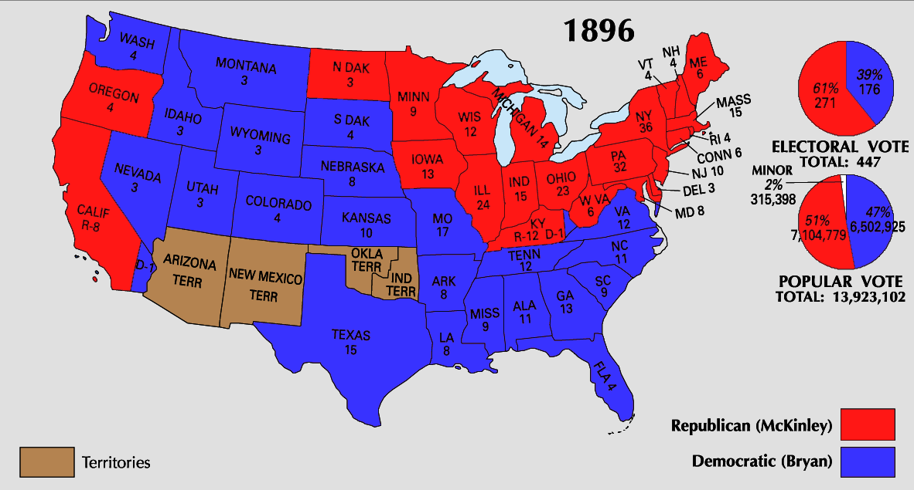
The Election of 1896
The election of 1896 killed the Populist Party, but key Populist ideas (income tax, secret ballot, & direct election of Senators) would be enacted by other parties

Slide 81
The McKinley Administration

Slide 82
The McKinley Administration
Republicans benefited from an improving economy, better crop production, & discoveries of gold:
The election of 1896 cemented Republican rule for 30 years & became the party of prosperity
From 1860-1890, Republicans had promoted industry; by 1900, it was time to regulate it

Slide 83
The McKinley Administration
McKinley was an activist president and became the first “modern” president:
He communicated well with the press
The Spanish-American War brought the USA respect as a world power
The Gold Standard Act (1900) ended the silver controversy
Notes:
Was McKinley the 1st modern president??

Slide 84
Conclusions: A Decade of Dramatic Changes

Slide 85
A Decade of Changes: The 1890s
The Depression of 1893 and the problems faced by farmers & industrial workers forced people to rethink industry, urbanization, & the quality of American life
Many embraced the need for reform which opened the door to the Progressive Era

Slide 86
National Government in the Gilded Age: A Sham of Democracy Activity
Notes:
Center for Learning Lesson #27

Slide 87
Problems of Farmers
Read each document from Problem of Farmers & write 1 sentence that explains a problem faced by farmers
The Wizard of Oz is a Populist allegory. Examine the list of characters from the story & guess who each character represents in the Gilded Age
Notes:
Lesson Plan for Thursday, December 6, 2007: Warm-up question, examine the characters in The Wizard of Oz, complete CFL Activity #20.

Slide 88
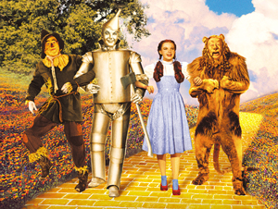
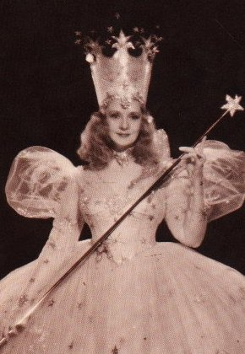
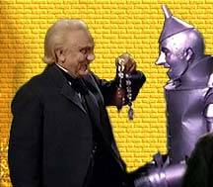
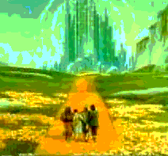
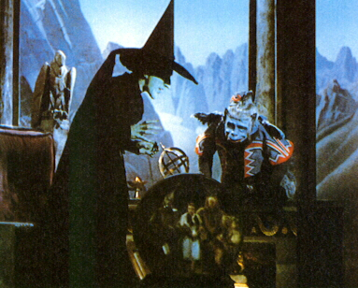
Populist Allegory—The Wizard of Oz
The Good Witch of the North? The Bad Witch of the East?
“Emerald City”? “Oz”? The Wizard?
What does each character represent?
What about the “Yellowbrick Road” and the “Ruby Slippers”?

